Slide 1
3D MOVING RICKSHA
Name: Anika Hossain
ID: 011 151 122
Name: Sazia Rumana
ID: 011151192

Slide 2
Introduction
It’s a 3D Project where we can move a rickshaw.
Keyboard keys control all the movement.
We can shift rickshaw position with right and left side movement using key.
Moto :
Implementation of translation, rotation, 3D Work.
Wanted to build a project of animation.

Slide 3
Individual Task:
Structure of the rickshaw
1. void display()
2. positioning all parts of a vehicle.

Slide 4
Individual Task:
KEY ACTIONS :
1. Adding wheel and make it dynamic.
2. All small mechanism of two wheel

Slide 5
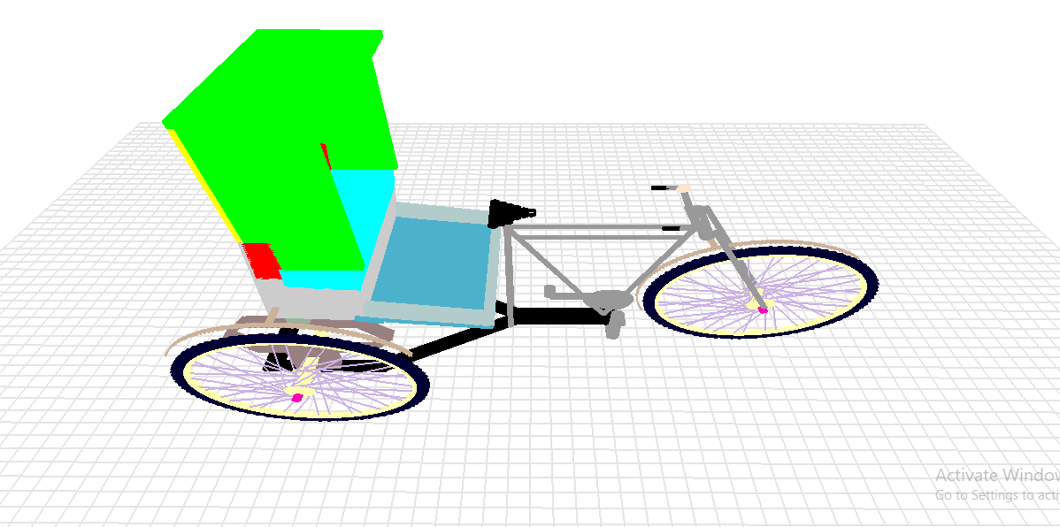

Slide 6
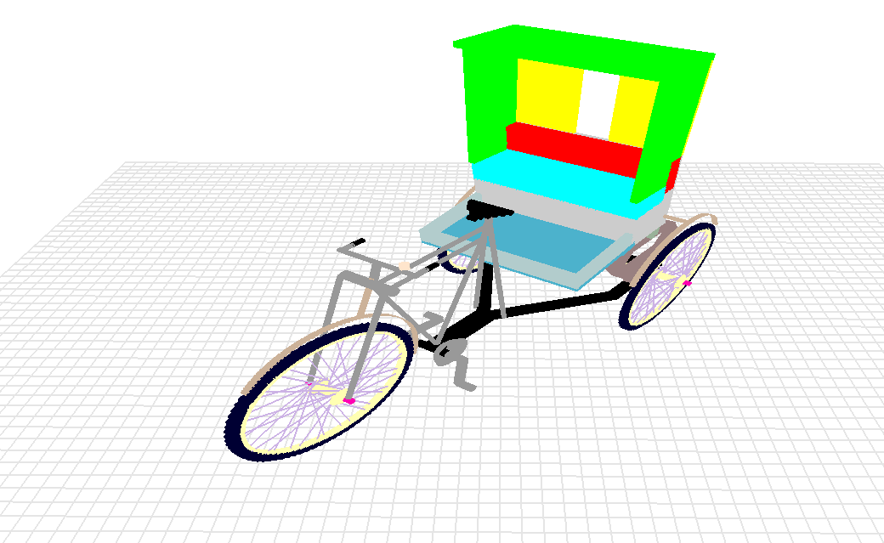
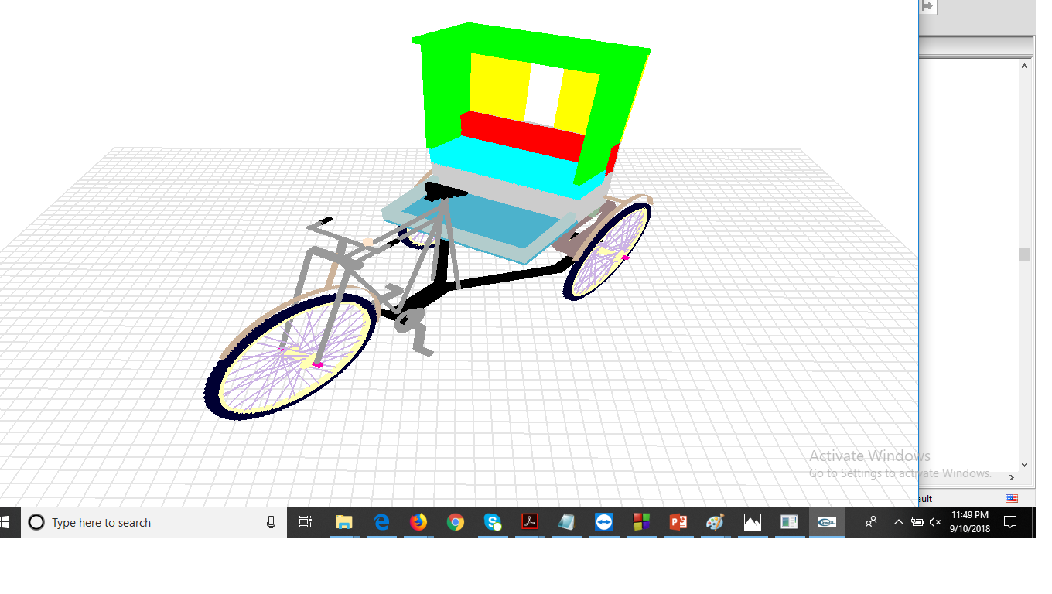

Slide 7
THANK YOU

